Slide 1
Data Visualization Of Bird Strikes
Ruby Varghese

Slide 2
Agenda
Problem Statement
Visualizations
Insights

Slide 3
Problem Statement
In the field of transportation and communication, particularly in aviation, bird strikes pose a significant safety concern. A bird strike occurs when a bird collides with an aircraft during flight, takeoff, or landing, potentially causing damage to the aircraft structure and posing a risk to passengers and crew. Despite efforts to mitigate this threat, bird strikes remain a persistent issue, leading to fatal accidents and financial losses for airlines.
The objective of this project is to analyze and understand the data collected on bird strikes by the Federal Aviation Administration (FAA) between 2000-2011,by examining trends, patterns, and factors associated with bird strikes.

Slide 4
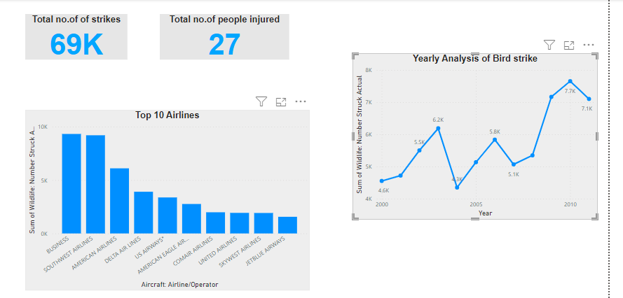

Slide 5
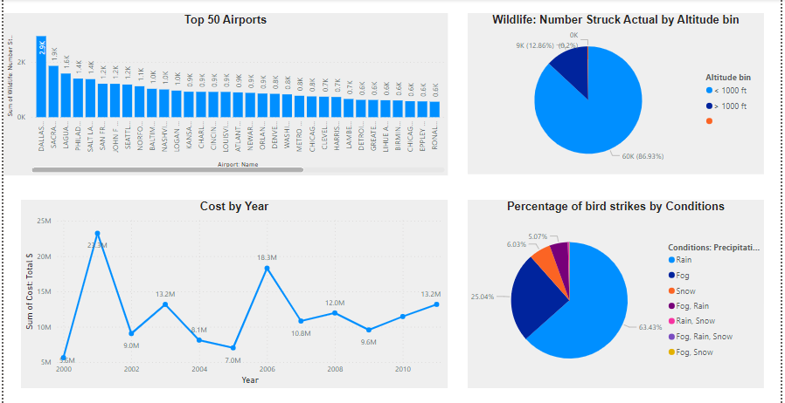

Slide 6
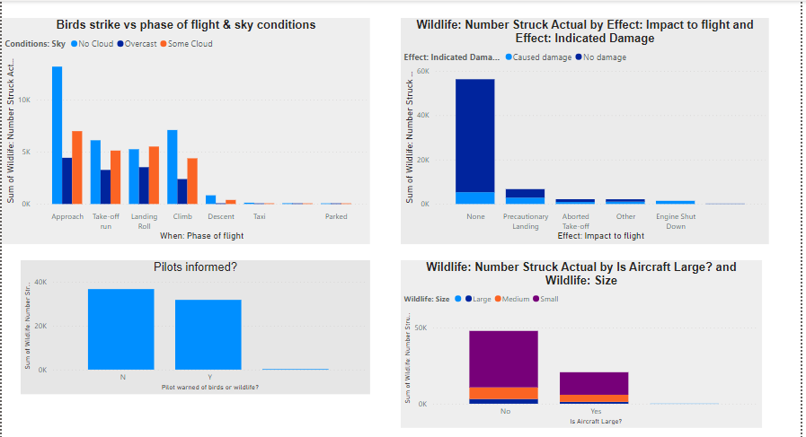

Slide 7
Insights
Number of actual bird strike 69K and 27 people are injured
Most bird strikes happened in the year of 2010 (7657).
More number of bird strikes are encountered in Business Airlines and SouthWest Airlines
Airport with more number of bird strike is Dallas/Fort Worth INTL.
86.93% of bird strike occurs at altitude <1000ft
63.43% of bird strike happened during Rain condition
Effect of bird strikes – Engine shutdown and damage caused for 1406 strikes.
Pilot were not informed by the bird strikes most of the times.
Many Aircraft strikes are caused by small size wildlife, & often the size of Aircraft involved also small.

Slide 8
THANK YOU

